Slide 1

Bacchus Winery Case Study
Alisa Steensen, Jose Franco, Usiel Figueroa, Carmen Mendoza

Slide 2

AGENDA
Group INTRODUCTION
Case study overview
Finalized erd
reports
Assumptions & design Decisions
Conclusion

Slide 3

Meet the team

Slide 4

The Team
Alisa Steensen: Lead Analyst - Played a pivotal role in gathering detailed business requirements and ensuring that the project goals were clearly defined and aligned with Bacchus Winery's operational objectives.
Usiel Figueroa: Database Designer – Expertly designed the ERD and database schema, ensuring normalization and establishing efficient relationships between entities.
Jose Franco: Query Specialist – Developed comprehensive SQL queries to retrieve and analyze critical data, facilitating insightful reporting for business decisions.
Carmen Mendoza: Report Specialist - Focuses on interpreting query results and creating visually engaging report templates that communicate key findings.

Slide 5

Case study Overview
Business Rules
Wine Distribution and Sales:
Track monthly wine sales to assess demand.
Evaluate distributor performance based on shipments, sales, and customer satisfaction.
Identify wines with dropping sales and create targeted marketing campaigns.
Generate quarterly reports on distributor accuracy, delivery, and sales performance.
Supplier Management:
Monitor monthly supplier deliveries and ensure schedules are met.
Check inventory levels monthly and flag items below reorder thresholds.
Track supplier performance (on-time deliveries and material quality).
Automate reorders to avoid stock shortages.
Employee Work Hours:
Log daily work hours and generate weekly, monthly, and quarterly reports.
Highlight employees working above or below department averages.
Notify department heads about irregular work hours.
Use work hour data in performance reviews to boost productivity and prevent burnout.

Slide 6
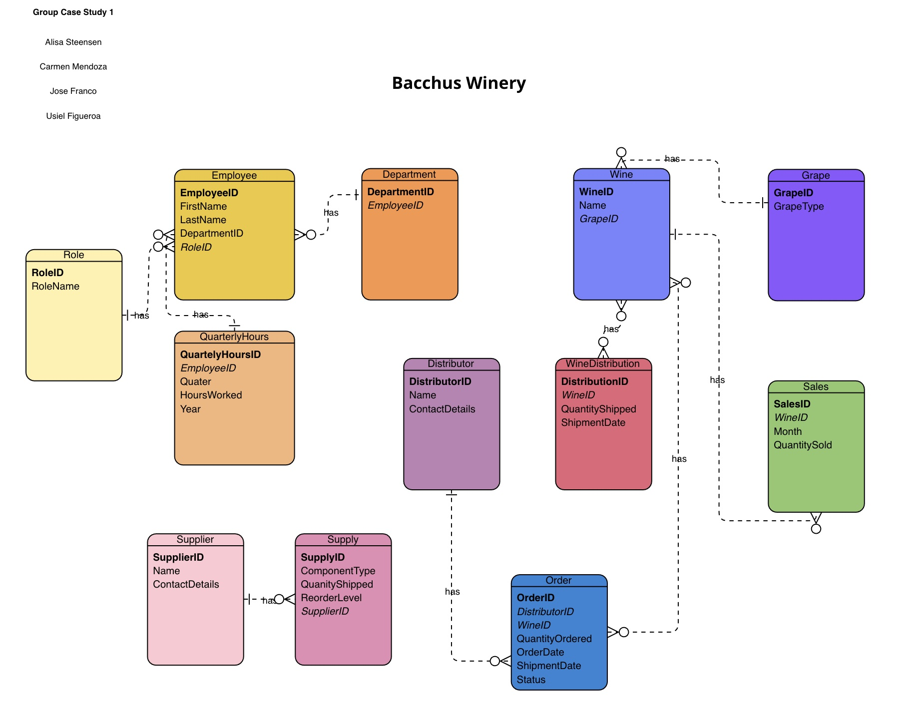
Finalized eRD
Employee and Department:
Each Employee works in one department.
A department can have multiple employees.
One-to-Many relationship
Employee and Quarterly Hours:
Each Employee accumulates hours worked.
Each Employee can work many hours.
One-to-Many relationship
Wine and Sales:
Each wine can have multiple sales records.
A sales record belongs to one specific wine.
One-to-Many relationship
Wine and Wine Distributor:
Each wine can be shipped by multiple distributors.
Each distributor can ship multiple wines.
Many-to-Many relationship

Slide 7

Reports generated
Supplier Delivery Performance Report: Identifies delayed deliveries and supplier gaps.
Monthly Delivery Gaps Report: Compares delays and total orders for each supplier by month.
Wine Sales Performance Report: Tracks total quantities shipped and sold by wine and distributors.
Employee Hours Report: Summarizes hours worked in the last four quarters.

Slide 8
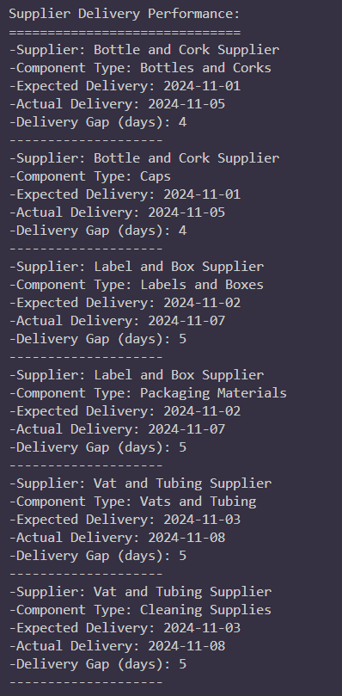
Supplier Reports
Description: This report provides an overview of the components supplied by each supplier, the quantity of components delivered, and the reorder levels. It helps the company monitor supplier deliveries and manage inventory more effectively by identifying if certain components are approaching low stock and require restocking. As it highlights whether a component needs restocking based on its current quantity shipped and the predefined reorder level. This report aids in ensuring that the company does not face production delays due to a lack of essential supplies.
Key Insights:
Expected Delivery.
Component Type.
Actual Delivery, helping to identify components that need restocking.
Delivery Gap, indicating if an item is running low and needs to be reordered.

Slide 9

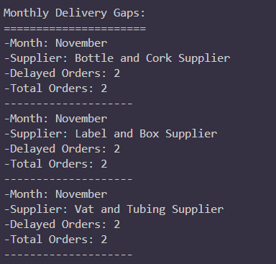
Monthly Delivery gaps report

Slide 10
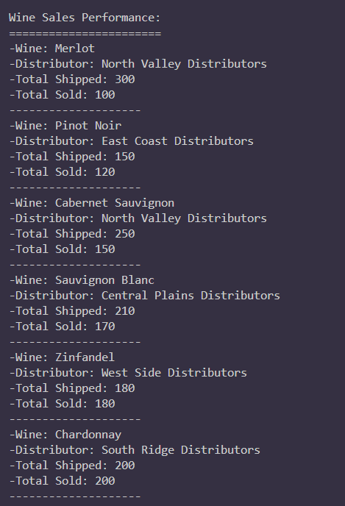
Wine Sales Report
Key Insights:
Wine names and their sales quantities.
Total Shipped, showing trends and peaks in demand.
Total sold, demand forecasting, and sales strategies.
Description: This report analyzes the performance of each wine product sold. Providing a clear picture of how different wines are performing over time. This report is particularly useful for business decisions related to marketing, inventory management, and future sales forecasts. By understanding which wines are performing well in each month, the company can adjust marketing strategies, focus on promoting specific wines, or optimize their supply chain to meet demand.

Slide 11
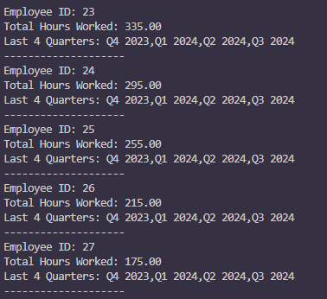
Employee Hours Report
Description: This report presents the total hours worked by each employee, categorized by their employee ID. This data helps in understanding workforce allocation, productivity, and the need for resource adjustments within departments. By comparing the number of hours worked in each department, management can identify areas where additional support may be needed or if any departments are overstaffed. It also provides insight into employee work distribution, which is important for decision-making related to compensation, promotions, or reallocating resources.
Key Insights:
Employee ID.
Last 4 Quarters.
Total hours worked, helping identify employees with heavy workloads or underutilization.

Slide 12
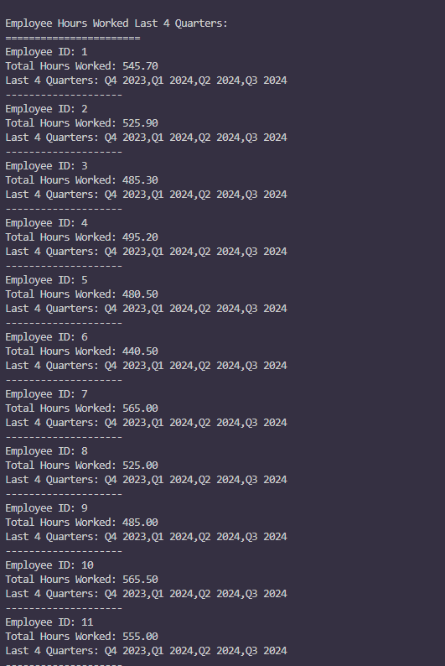
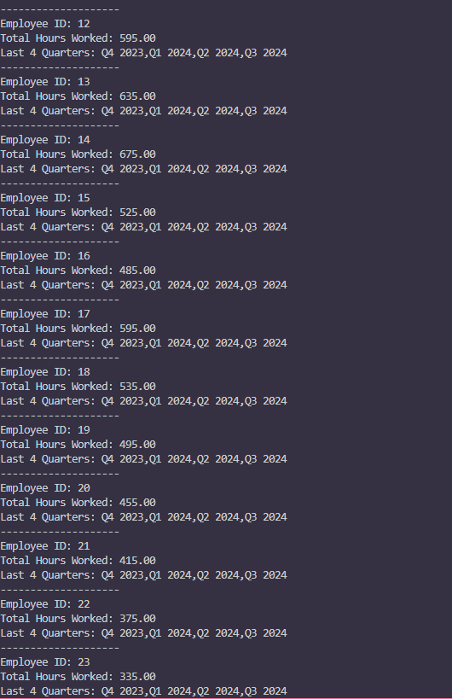

Employee Hours Report

Slide 13

Assumptions
Digital Transformation: The business will adopt modern digital systems, replacing manual processes, to enhance efficiency and data accuracy.
Supplier and Distributor Integration: Suppliers and distributors will be required to share comprehensive, real-time data for inventory, delivery schedules, and sales tracking via integrated digital platforms.
Current State Assessment: Existing manual processes will be systematically reviewed and optimized during the transition to digital systems to ensure a smooth shift.
Strategic Investment: Investment in online platforms, including cloud-based inventory management and analytics tools, is prioritized to support the transition.
Enhanced Data Sharing: Distributors will provide detailed, real-time sales and shipment data, enabling accurate performance tracking and timely decision-making.

Slide 14

Design Decisions
Transition from manual processes to a digital database system for efficiency.
Automate Processes:
Use automated systems for inventory management, supplier tracking, employee work hours, and wine shipments.
Set up automatic reordering for low stock.
Centralized Data:
Create a single database to manage all supplier, distributor, sales, and internal operations data.
Keep data updated in real-time for quick decision-making.
Easy Reporting:
Build simple tools to generate weekly, monthly, and yearly reports for sales, productivity, and supplier performance.
User-Friendly Design:
•Provide easy-to-use systems for employees, suppliers, and distributors to input and track data.
•Allow managers to view custom reports focused on their goals.
Secure and Compliant:
•Protect sensitive data with strong security measures.
•Follow all data protection laws to maintain trust.
Performance Monitoring:
•Track how well the systems work and make improvements based on feedback and results.

Slide 15
COnclusion
The designed database system aligns with Bacchus Winery's operational needs and addresses inefficiencies in supply chain management, employee hour tracking, and wine distribution analysis.
Reports provide actionable insights for better decision making, such as identifying delayed suppliers, improving wine sales strategies, and evaluating employee productivity.
Improved operational efficiency through automation of manual processes.
Real-time tracking and reporting to enable proactive issue resolution.
A scalable solution that can grow with the business as new requirements emerge.
Seek feedback
Reflect on performance
Explore new techniques
Set personal goals
Iterate and adapt

Slide 16

THANK YOU
Alisa Steensen
Jose Franco
Usiel Figueroa
Carmen Mendoza

